Slide 1

Pizza Sales Analysis
Using SQL
By
Dhanshree Umare

Slide 2

Objectives
The Pizza Sale s Project Harnesses the power of SQL to transform raw sales data into meaningful insights . This project is to analyze pizza sales data to identify trends and provide actionable insights that can help to increase sales and aim to uncover key metrics and patterns within the sales data by leveraging SQL queries in MySQL.

Slide 3


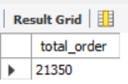
Retrieve the total number of orders placed.

Slide 4
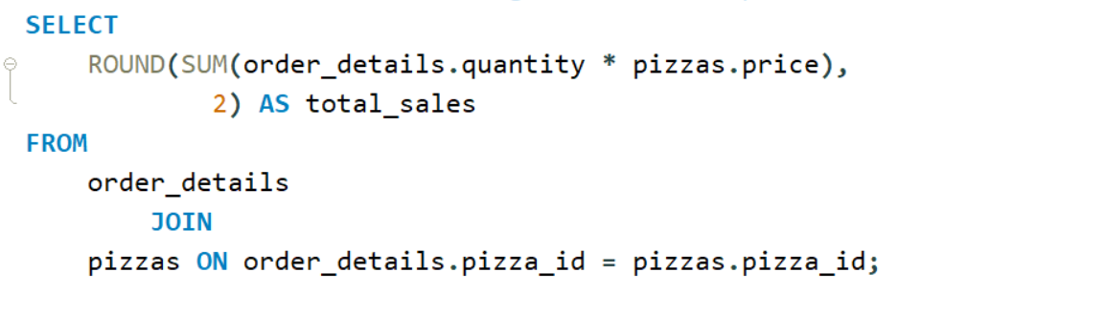
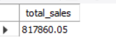
Calculate the total revenue generated from pizza sales.

Slide 5
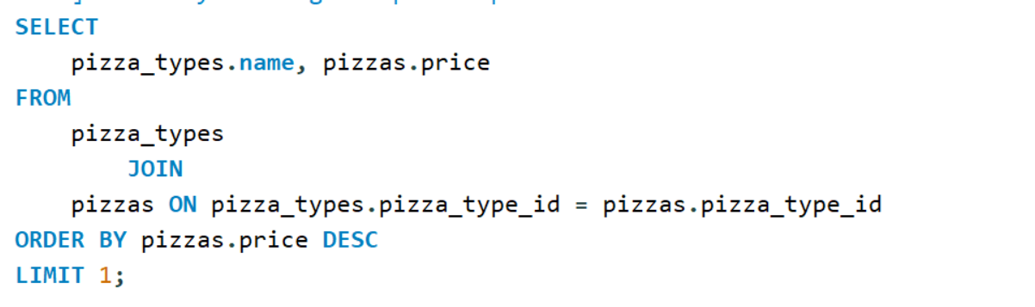
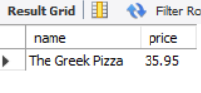
Identify the highest-priced pizza.

Slide 6
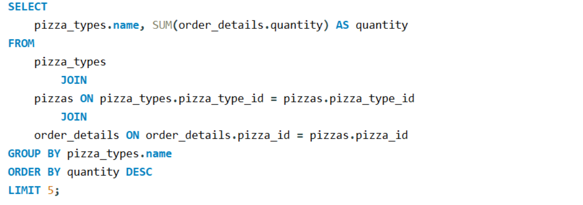
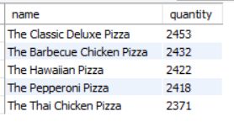
List the top 5 most ordered pizza types along with thier quantities.

Slide 7
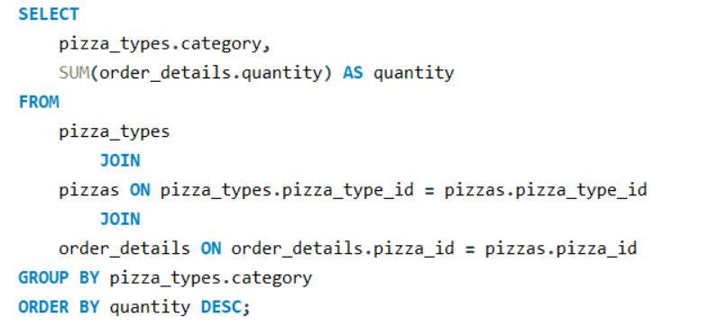
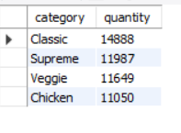
Join the necessary tables to find the total quantity of each pizza category ordered.

Slide 8
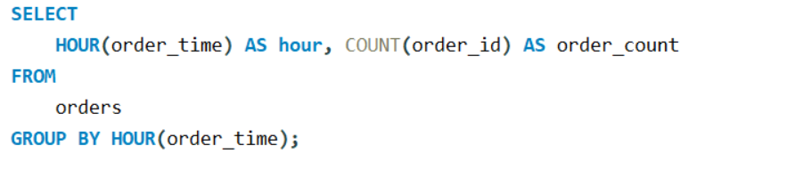
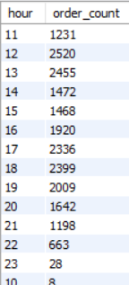
Determine the distribution of orders by hour of the day.

Slide 9
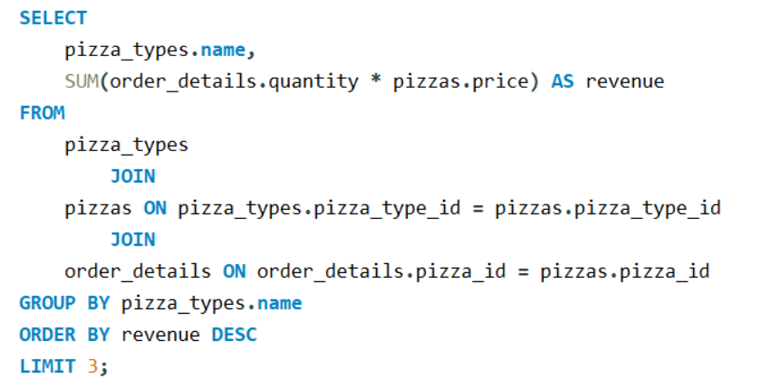
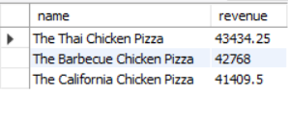
Determine the top 3 most ordered pizza types based on revenue.

Slide 10
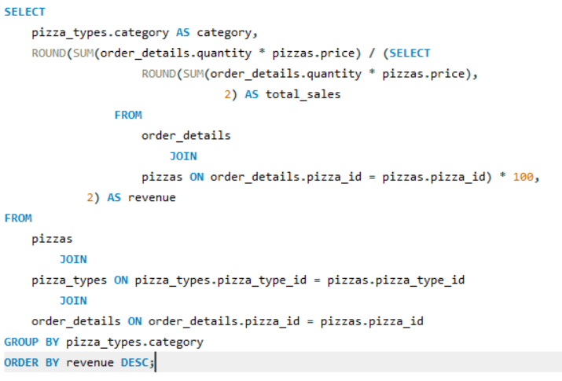
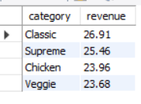
Calculate the percentage contribution of each pizza type to total revenue.

Slide 11
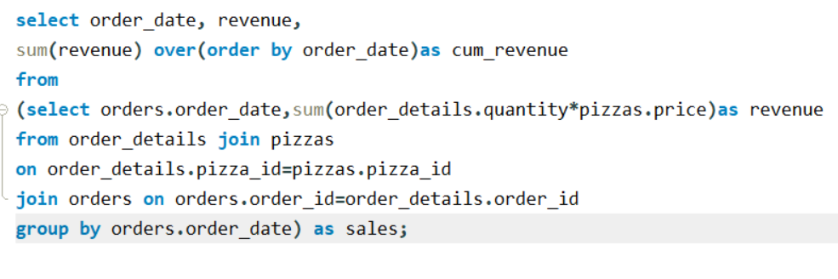
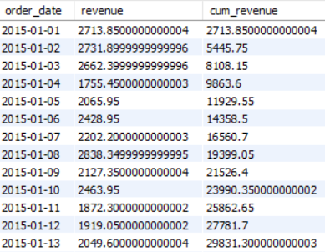
Analyze the cumulative revenue generated over time.

Slide 12
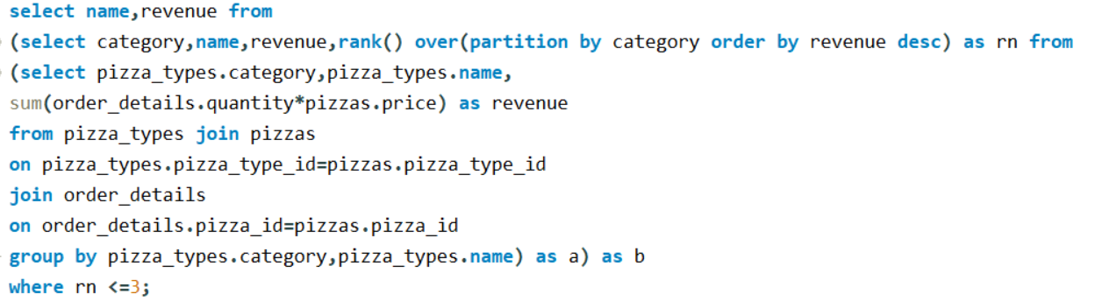
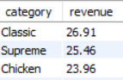
Determine the top 3 most ordered pizza types based on revenue for each pizza category.

